Slide 1



Implementing Transformer with Python & PyTorch
Quang Duong

Slide 3


Implementing Transformer for machine translation task
Training
Inference
Source:
Target:
"I am fine"
Transformer
"Je vais bien"
Source:
"Market prices are shaped by the balance of supply and demand. "
Target:
Transformer
?

Slide 4

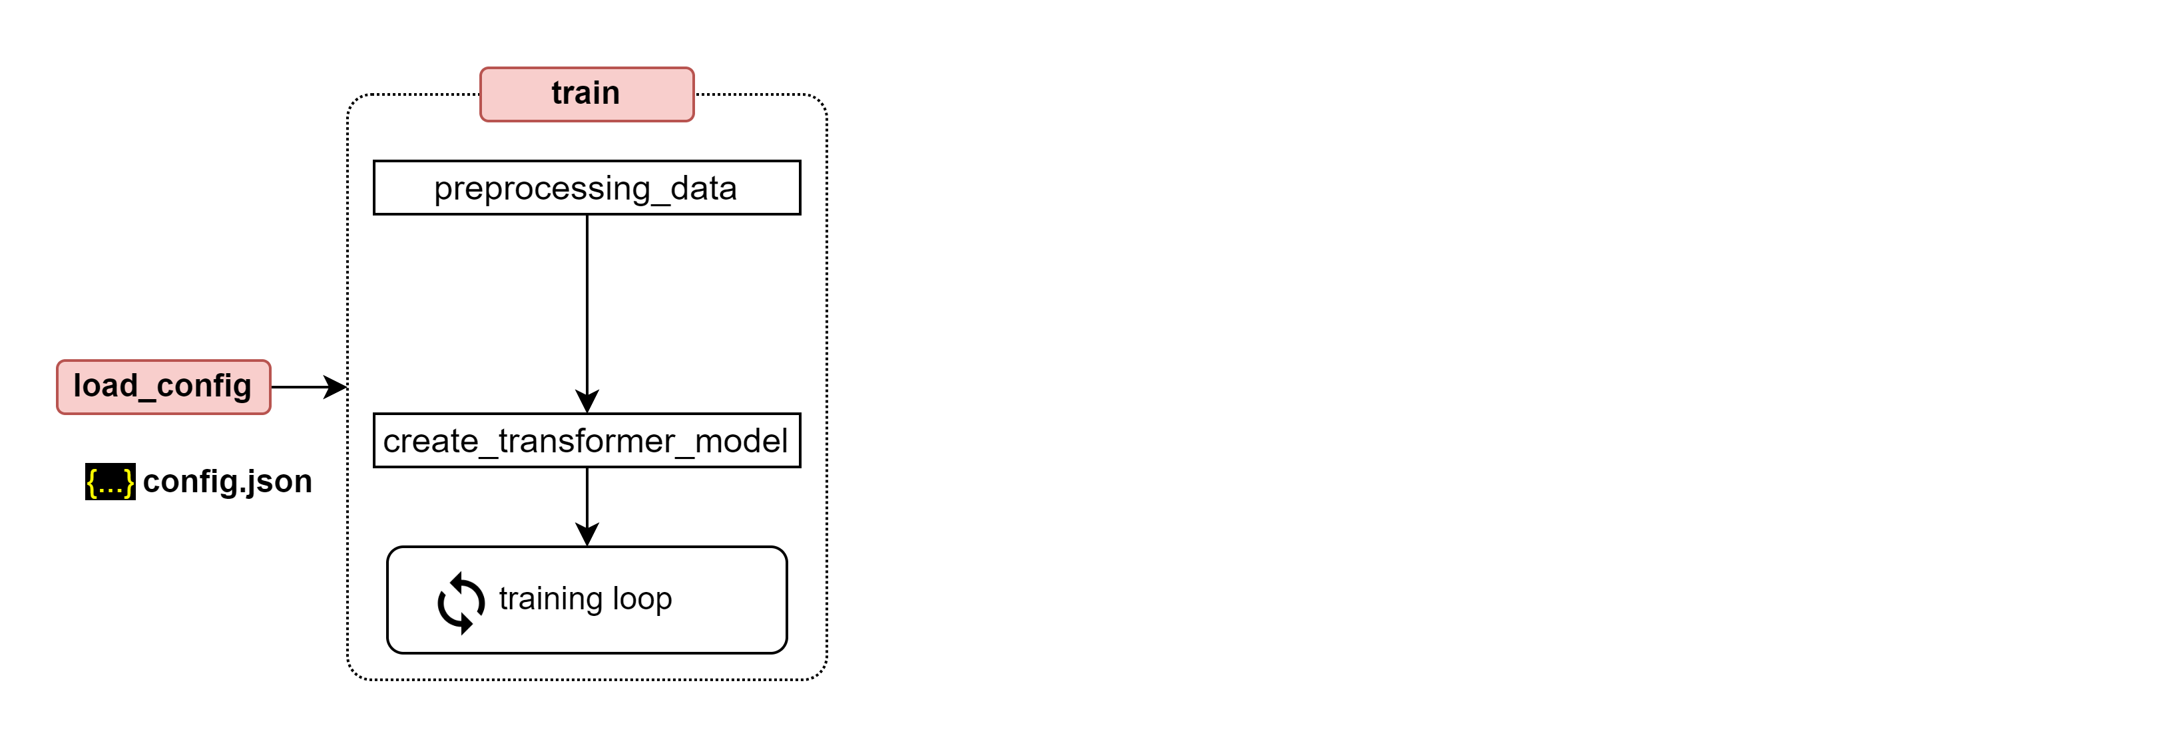
Training process for transformer

Slide 5
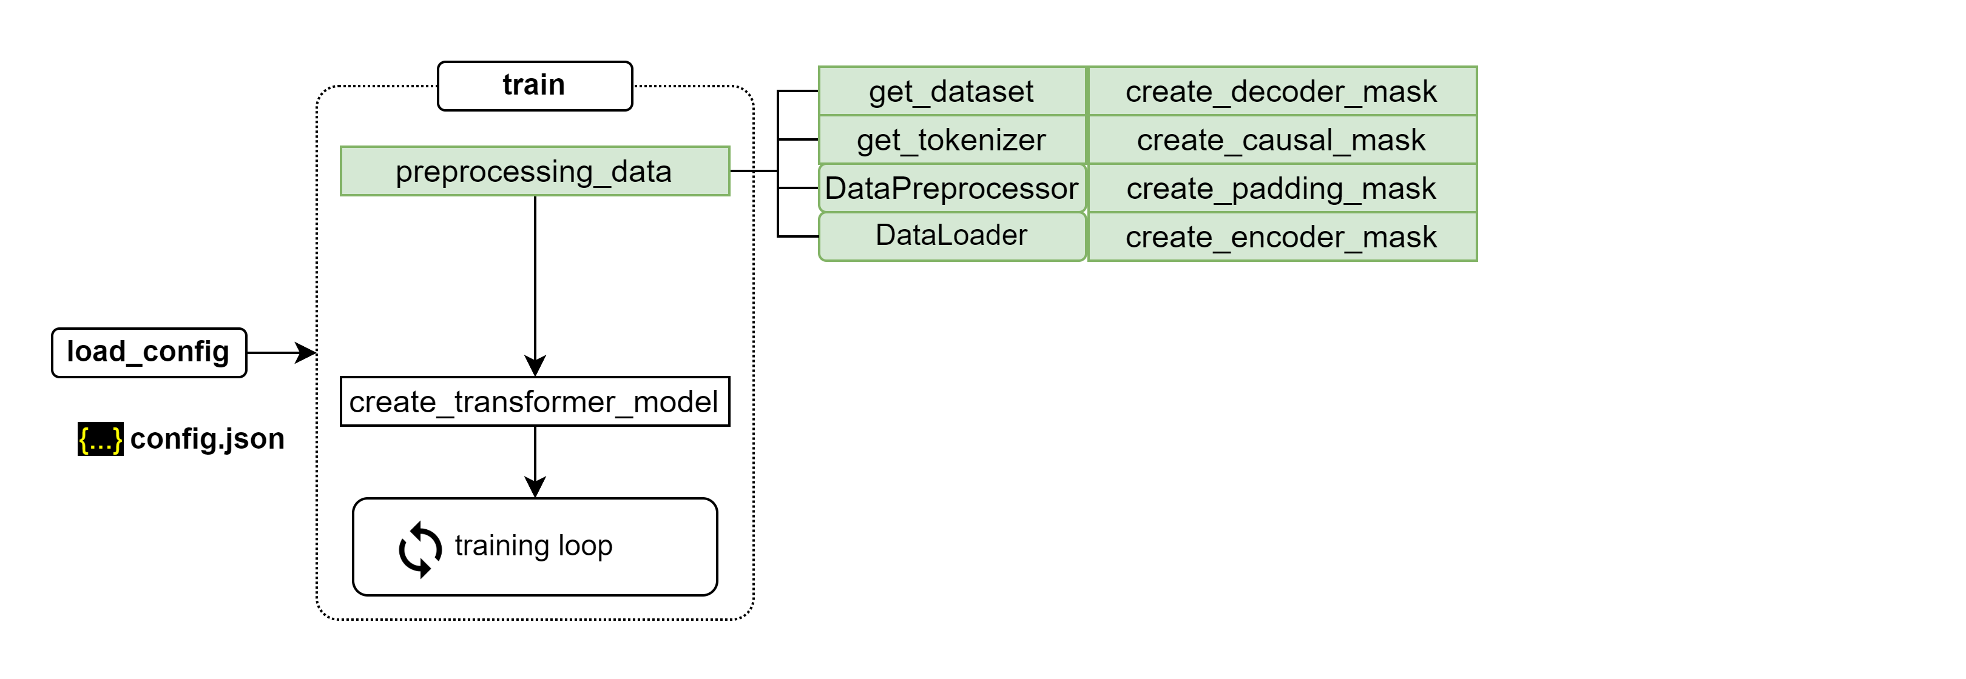
Training process for transformer

Slide 6
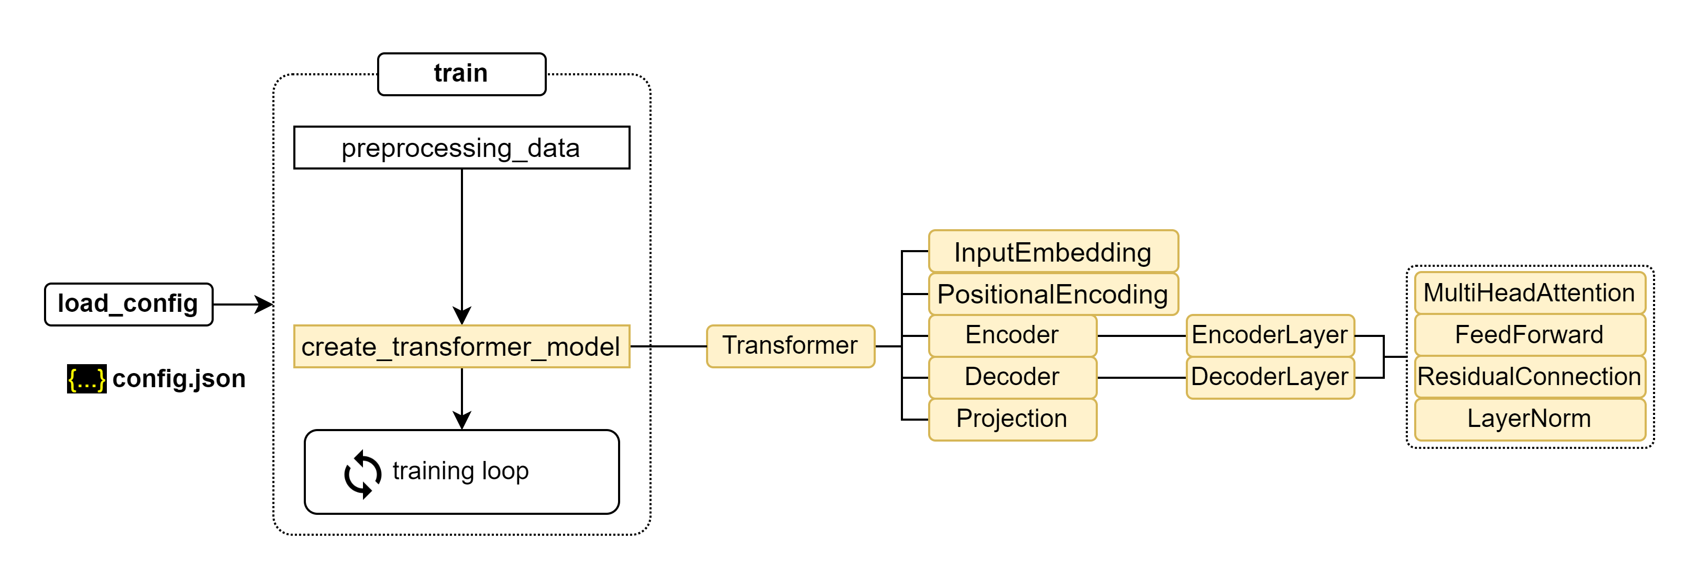
Training process for transformer

Slide 7
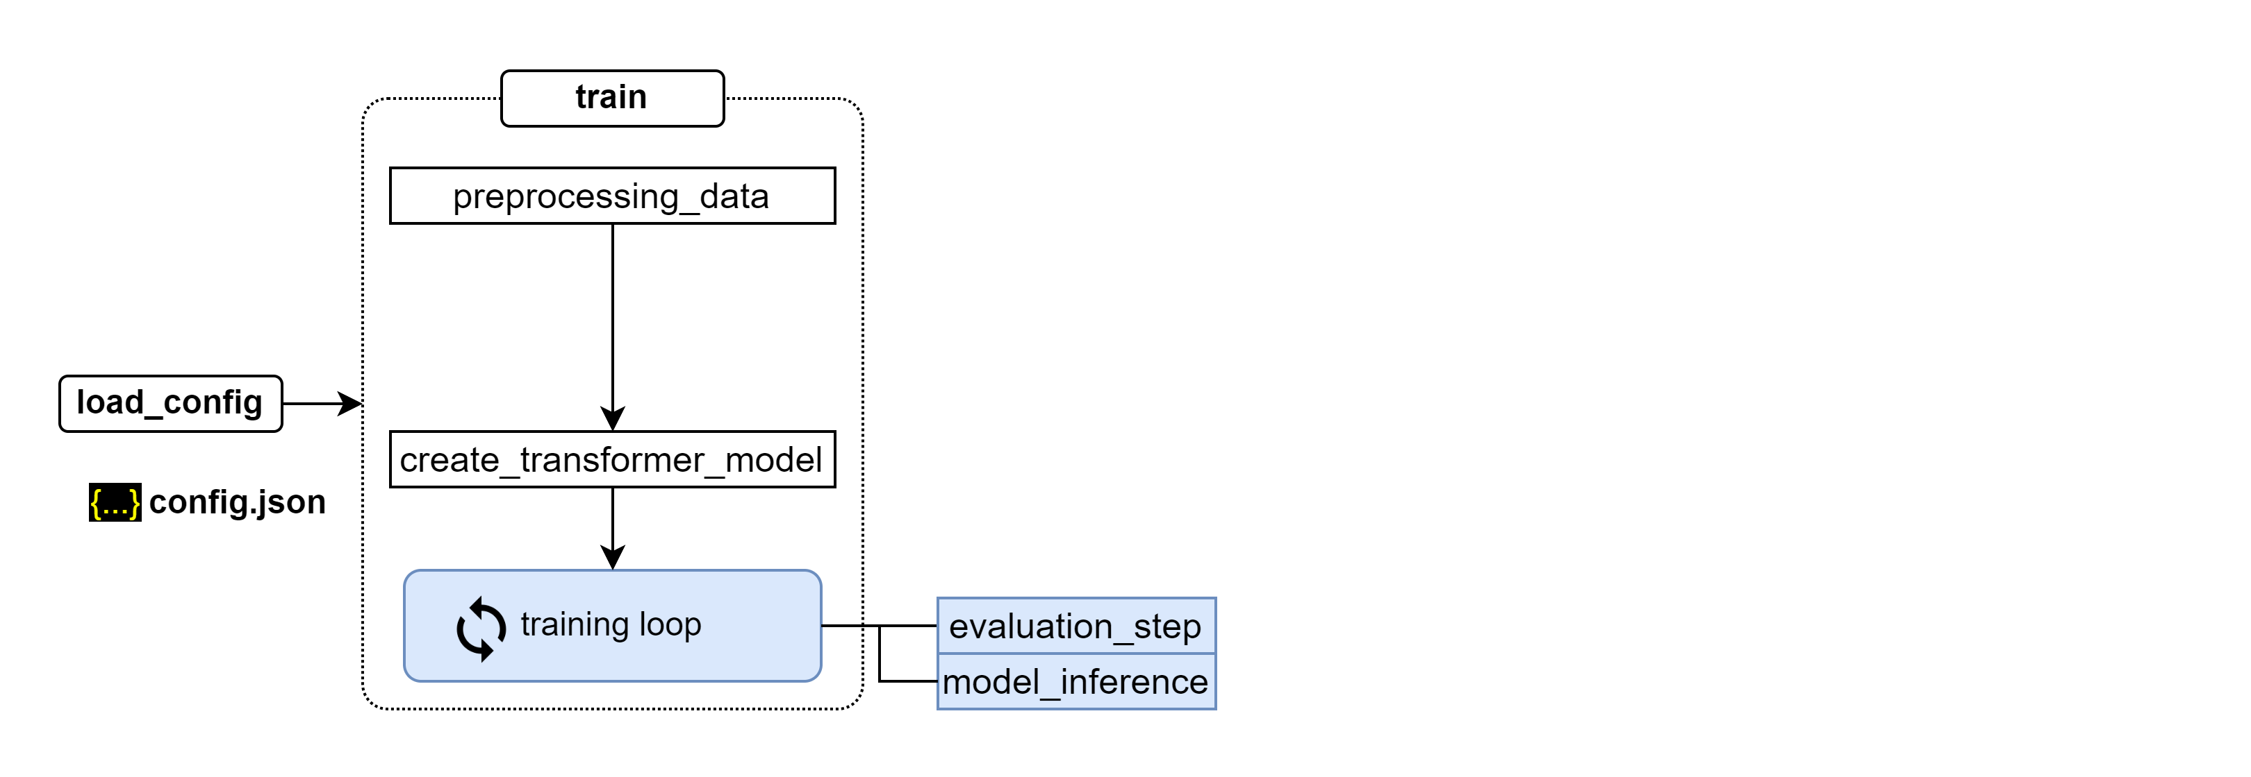
Training process for transformer

Slide 8
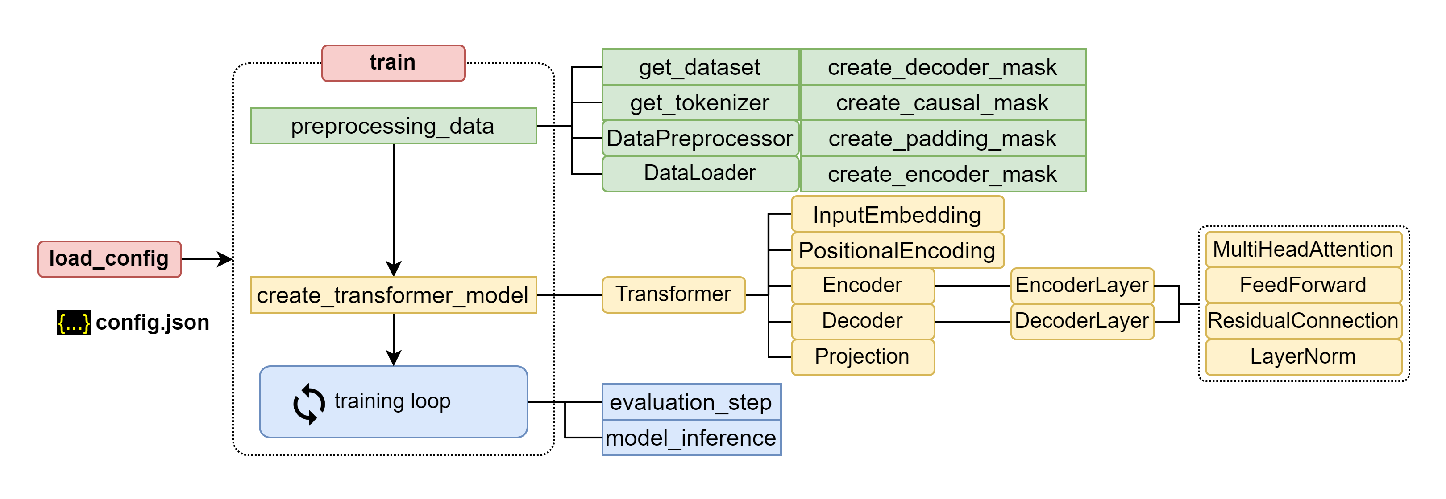
Training process for transformer

Slide 10
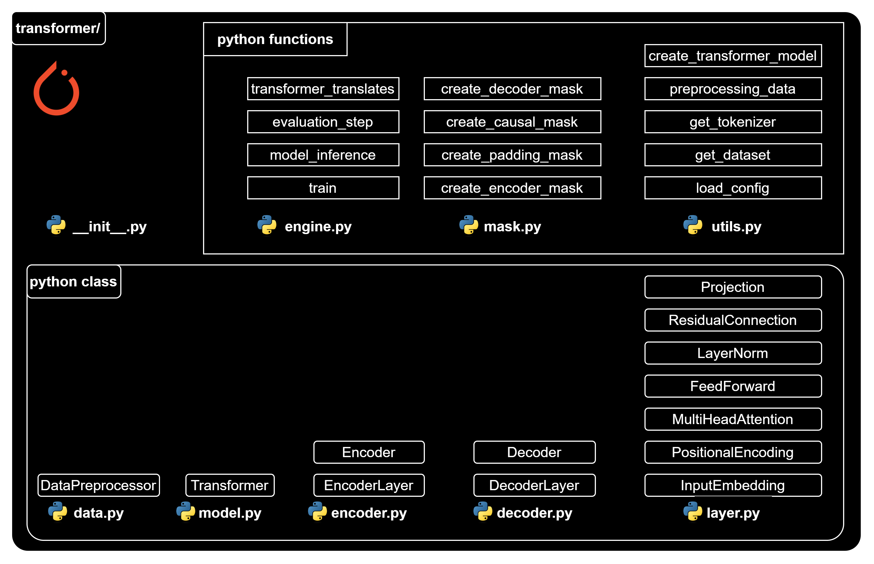
Implementing Transformer

Slide 11
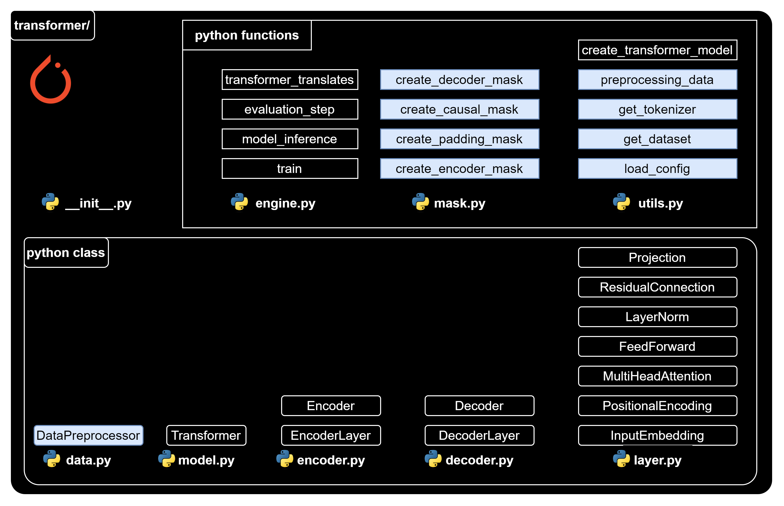
Implementation Plan (1/4)

Slide 12
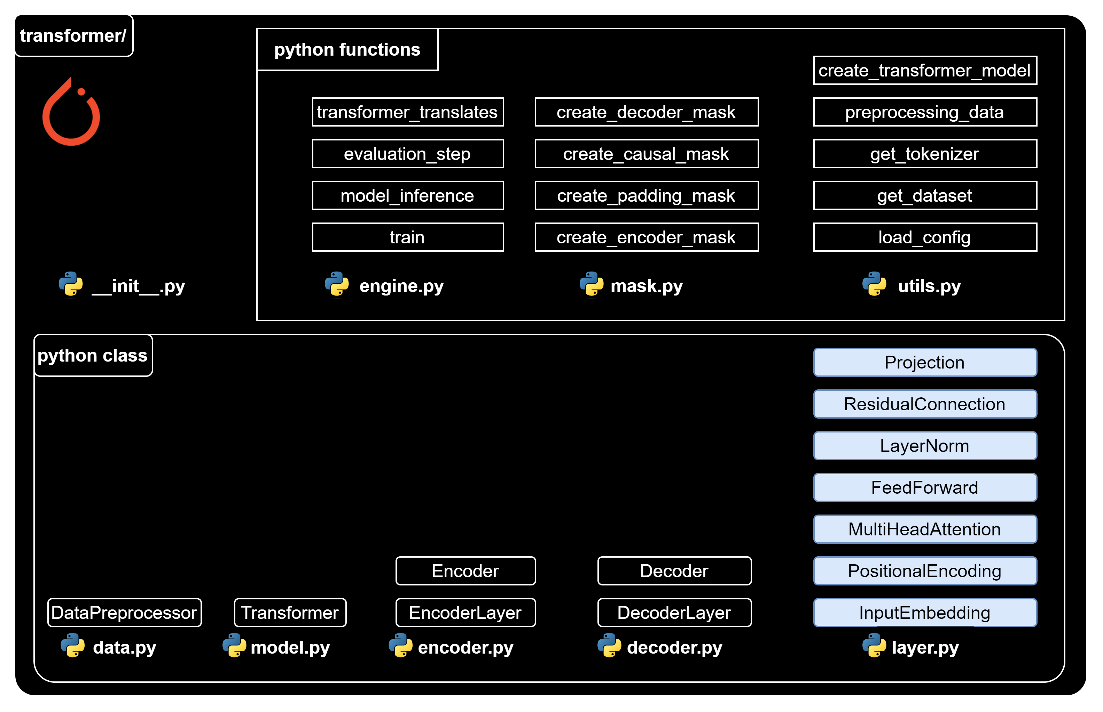
Implementation Plan (2/4)

Slide 13
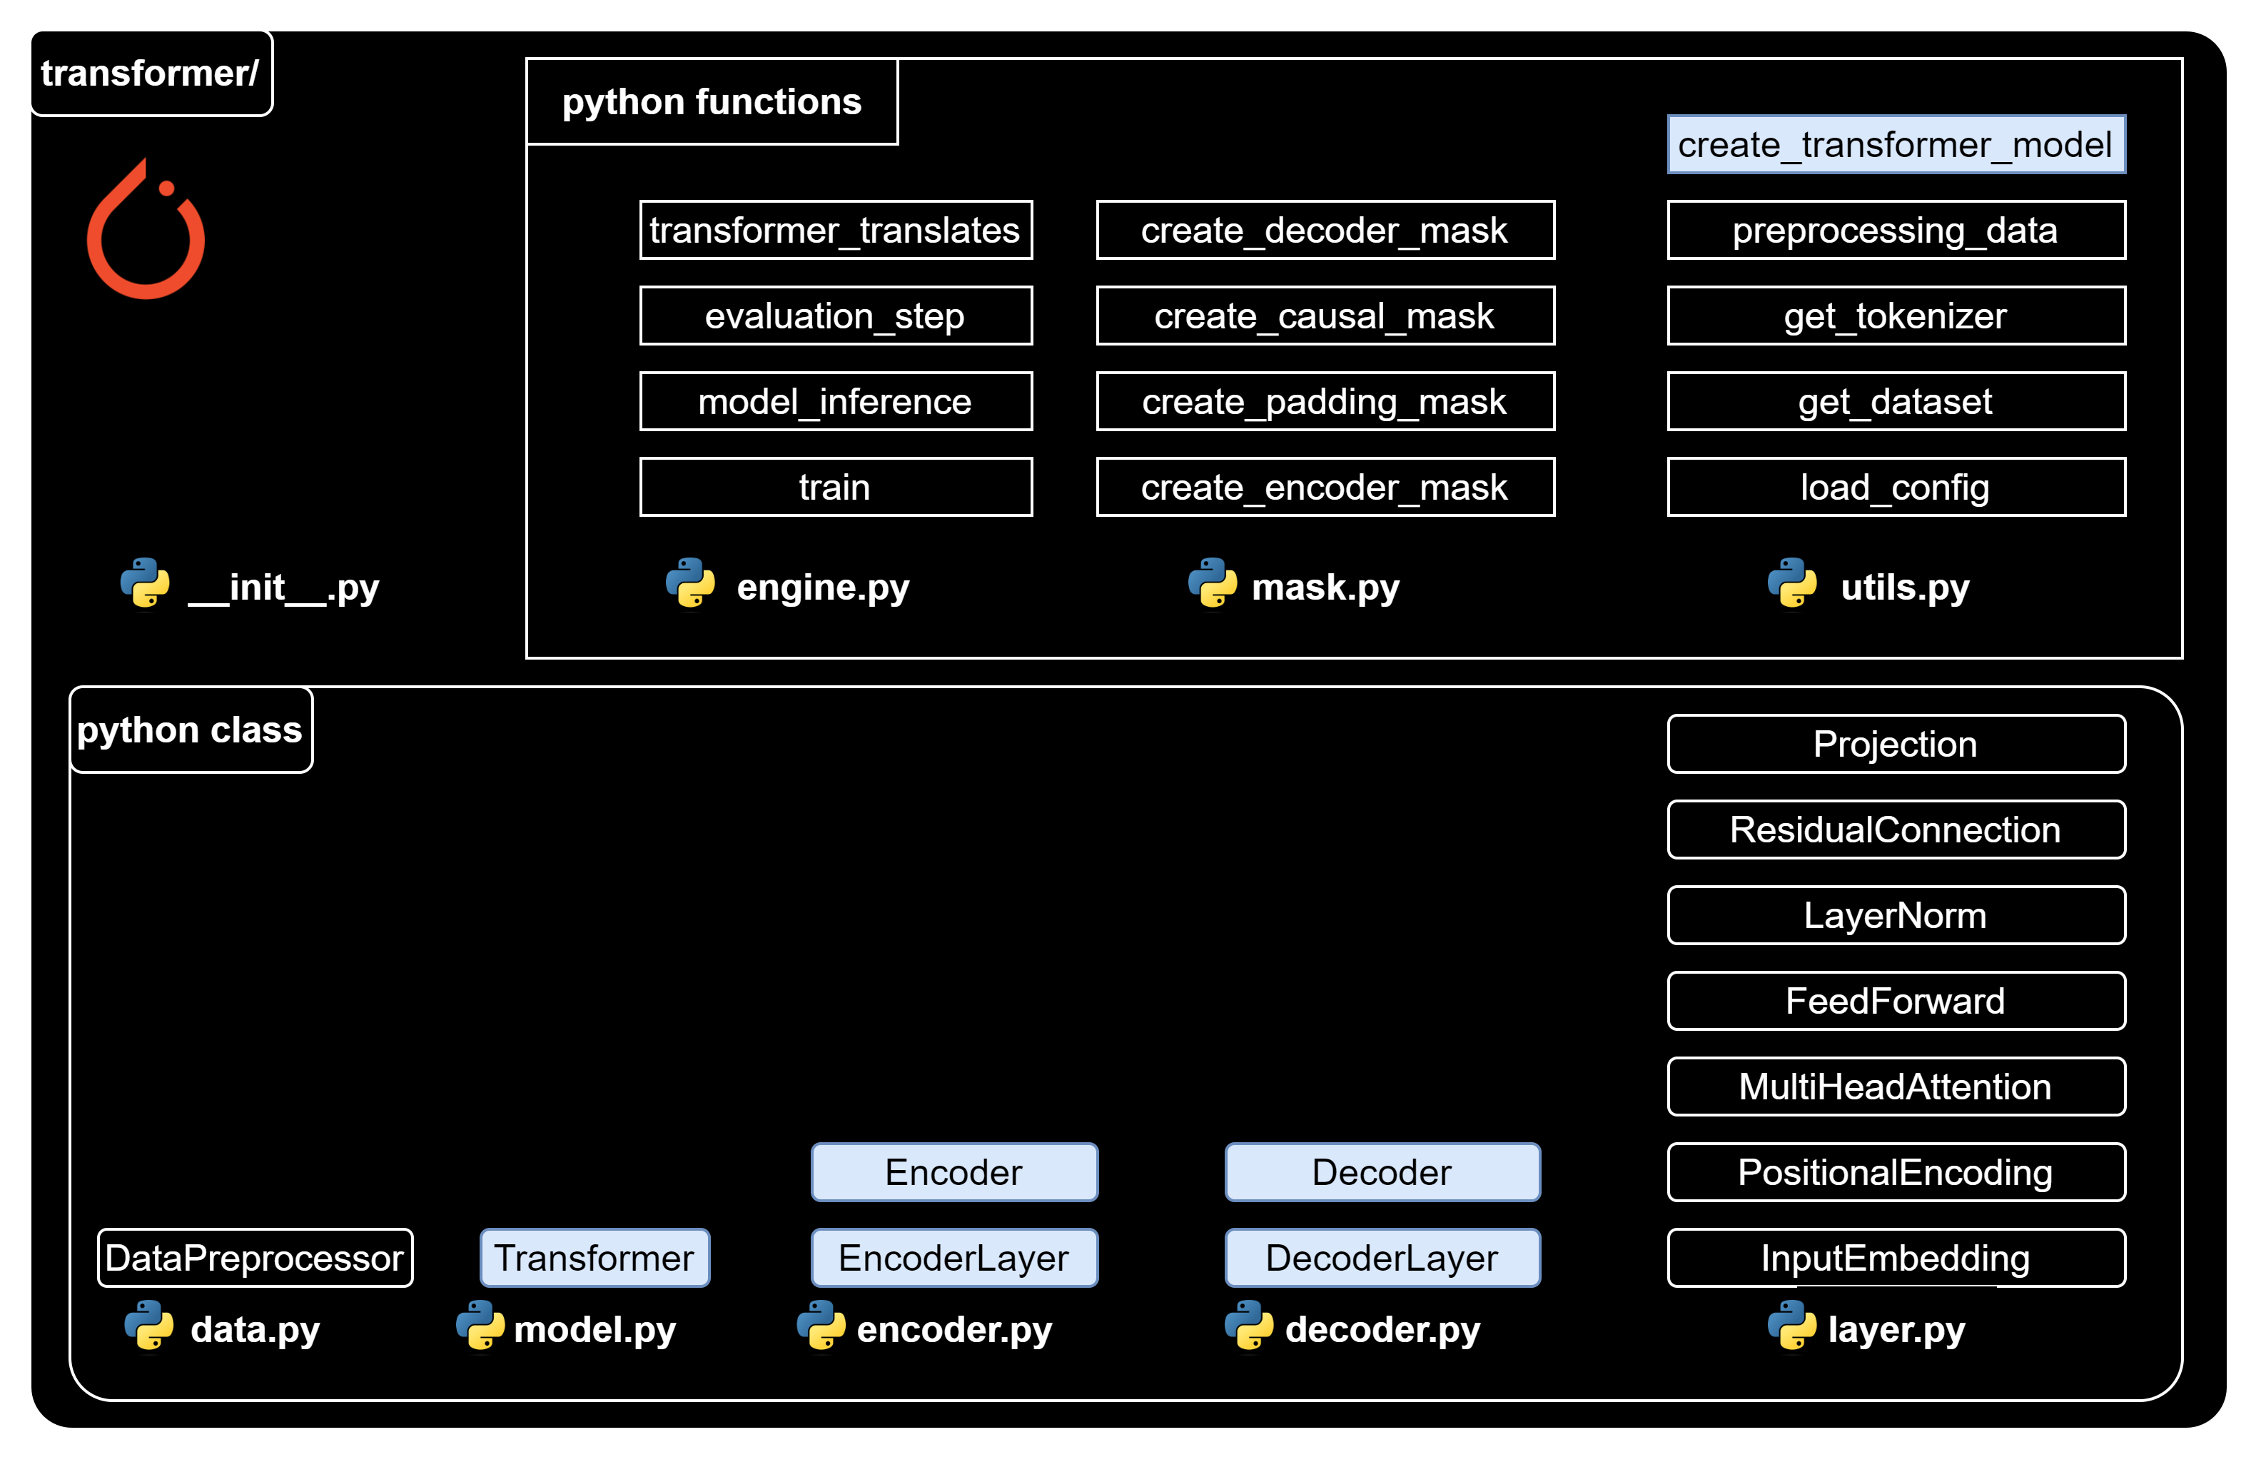
Implementation Plan (3/4)

Slide 14
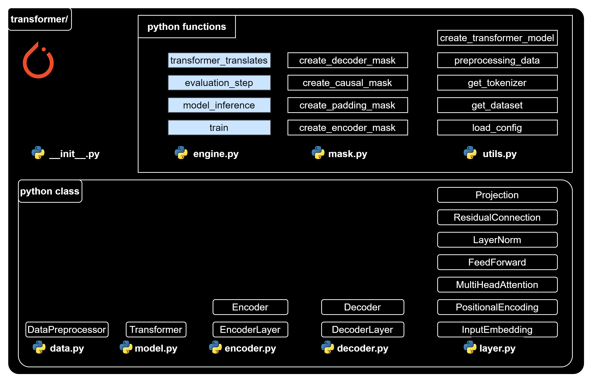
Implementation Plan (4/4)

Slide 16
Implementation Approach
Coding step-by-step + Notebook demonstration + Example result
= Understanding

Slide 18
Implementation Plan (1/4)

Slide 19
Utils – Load config
utils.py
import json
def load_config(config_file_path):
# Open the file in read mode
with open(config_file_path, "r") as f:
# Load the JSON content of the file into a Python dictionary
config = json.load(f)
# Return the configuration data
return config

Slide 20
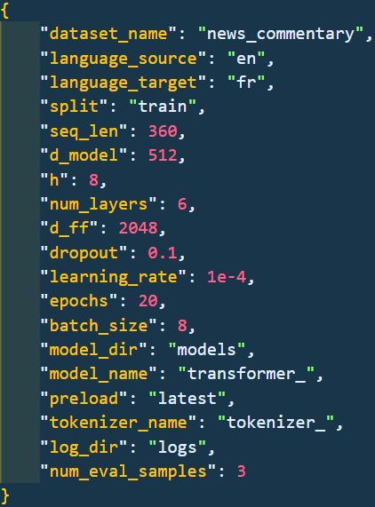
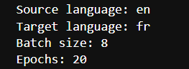
Utils – Load config
nb_load_config.ipynb
{…} config.json
import sys
sys.path.append('../')
from transformer.utils import load_config
config_file_path = "../config.json"
config = load_config(config_file_path)
print("Source language:", config['language_source'])
print("Target language:", config['language_target'])
print("Batch size:", config['batch_size'])
print("Epochs:", config['epochs'])

Slide 22
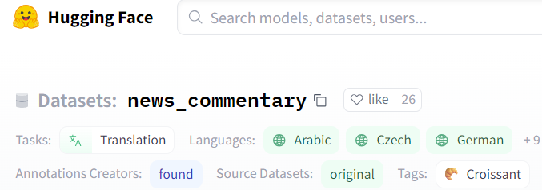
Utils – Get dataset
utils.py
from datasets import load_dataset
def get_dataset(config):
# Extract the dataset name, source language, target language, and split from the config
dataset_name = config["dataset_name"] # “news_commentary”
lang_src = config["language_source"] # “en”
lang_tgt = config["language_target"] # “fr”
split = config["split"]
# Construct the language pair string
language_pair = f"{lang_src}-{lang_tgt}"
# Load the dataset using the provided parameters
raw_dataset = load_dataset(dataset_name, language_pair, split=split)
# Return the loaded dataset
return raw_dataset

Slide 23
Utils – Get dataset
nb_load_config.ipynb
import sys
sys.path.append('../')
from transformer.utils import load_config, get_dataset
## Load config
config_file_path = "../config.json"
config = load_config(config_file_path)
# Load dataset
dataset = get_dataset(config)
print(dataset['translation'][:2])

Slide 25
Utils – Get Tokenizer
utils.py
from pathlib import Path
from tokenizers import Tokenizer, models, pre_tokenizers, trainers
def get_tokenizer(config, dataset, language):
# Extract the tokenizer name from the config and construct the tokenizer file path
tokenizer_name = config["tokenizer_name"]
tokenizer_path = f"{tokenizer_name}{language}.json"
# Check if a tokenizer file already exists at the specified path
if Path.exists(Path(tokenizer_path)):
# If it does, load the tokenizer from that file
tokenizer = Tokenizer.from_file(tokenizer_path)
else:
# If it doesn't, create a new tokenizer
tokenizer = Tokenizer(models.WordLevel(unk_token="[UNK]"))
tokenizer.pre_tokenizer = pre_tokenizers.Whitespace()

Slide 26
Utils – Get Tokenizer
utils.py
# Create a trainer for the tokenizer
trainer = trainers.WordLevelTrainer(
min_frequency=2,
special_tokens=["[PAD]", "[UNK]", "[SOS]", "[EOS]"],
)
# Train the tokenizer on the provided dataset
tokenizer.train_from_iterator(
(item[language] for item in dataset["translation"]), trainer=trainer
)
# Save the trained tokenizer to the specified path
tokenizer.save(tokenizer_path)
# Return the tokenizer
return tokenizer

Slide 27
Utils – Get Tokenizer
nb_get_tokenizer.ipynb
import sys
sys.path.append('../')
from transformer.utils import load_config, get_dataset, get_tokenizer
from pathlib import Path
## Load config
config_file_path = "../config.json"
config = load_config(config_file_path)
# Load dataset
dataset = get_dataset(config)
print(dataset['translation'][:2])
## Load tokenizer
tokenizer_src = get_tokenizer(config, dataset, config['language_source'])
tokenizer_tgt = get_tokenizer(config, dataset, config['language_target'])

Slide 28
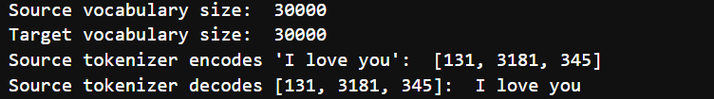
Utils – Get Tokenizer
nb_get_tokenizer.ipynb
## Explore tokenizer
# check vocabulary size
print("Source vocabulary size: ", tokenizer_src.get_vocab_size())
print("Target vocabulary size: ", tokenizer_tgt.get_vocab_size())
# Check source tokenizer encodes/decodes
print("Source tokenizer encodes 'I love you': ", tokenizer_src.encode('I love you').ids)
print("Source tokenizer decodes [131, 3181, 345]: ", tokenizer_src.decode([131, 3181, 345]))

Slide 30
Mask – Create encoder mask
mask.py
import torch
def create_encoder_mask(encoder_input_ids, pad_token_id):
return (encoder_input_ids != pad_token_id).unsqueeze(0).unsqueeze(0).int()
def create_padding_mask(decoder_input_ids, pad_token_id):
return (decoder_input_ids != pad_token_id).unsqueeze(0).int()
def create_causal_mask(seq_len):
return (torch.triu(torch.ones((1, seq_len, seq_len)), diagonal=1).type(torch.int) == 0)
def create_decoder_mask(decoder_input_ids, pad_token_id, seq_len):
padding_mask = create_padding_mask(decoder_input_ids, pad_token_id)
causal_mask = create_causal_mask(seq_len)
return padding_mask & causal_mask

Slide 31
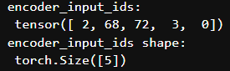
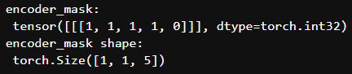
Mask – Create encoder mask
nb_mask.ipynb
import sys
sys.path.append('../')
import torch
from transformer.mask import *
# Create the inputs
en_input_ids = torch.tensor([ 2, 68, 72, 3, 0])
pad_id = torch.tensor([0]) # pad token id
# Create encoder mask
encoder_mask = create_encoder_mask(
en_input_ids,
pad_id) # (1, 1, seq_len)
print("encoder_input_ids: \n", encoder_input_ids)
print("encoder_input_ids shape: \n", encoder_input_ids.shape)
print("encoder_mask: \n", encoder_mask)
print("encoder_mask shape: \n", encoder_mask.shape)

Slide 32
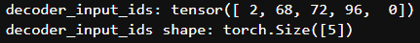
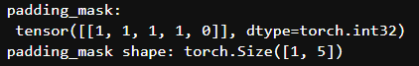
Mask – Create padding mask
nb_mask.ipynb
import sys
sys.path.append('../')
import torch
from transformer.mask import *
# Create the inputs
de_input_ids = torch.tensor([ 2, 68, 72, 96, 0])
pad_id = torch.tensor([0]) # pad token id
seq_len = 5 # sequence length
# Create padding mask # (1, seq_len)
padding_mask = create_padding_mask(
de_input_ids,
pad_id)
print("decoder_input_ids:", decoder_input_ids)
print("decoder_input_ids shape:", decoder_input_ids.shape)
print("padding_mask: \n", padding_mask)
print("padding_mask shape:", padding_mask.shape)

Slide 33
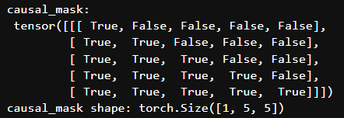
Mask – Create causal mask
nb_mask.ipynb
import sys
sys.path.append('../')
import torch
from transformer.mask import *
# Create the inputs
de_input_ids = torch.tensor([ 2, 68, 72, 96, 0])
pad_id = torch.tensor([0]) # pad token id
seq_len = 5 # sequence length
# Create a causal mask # (1, seq_len, seq_len)
causal_mask = create_causal_mask(seq_len)
print("decoder_input_ids:", decoder_input_ids)
print("decoder_input_ids shape:", decoder_input_ids.shape)
print('causal_mask: \n', causal_mask)
print('causal_mask shape:', causal_mask.shape)

Slide 34
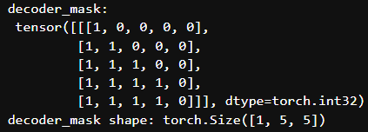
Mask – Create decoder mask
nb_mask.ipynb
import sys
sys.path.append('../')
import torch
from transformer.mask import *
# Create the inputs
de_input_ids = torch.tensor([ 2, 68, 72, 96, 0])
pad_id = torch.tensor([0]) # pad token id
seq_len = 5 # sequence length
# Create decoder mask # (1, seq_len, seq_len)
decoder_mask = create_decoder_mask( de_input_ids,
pad_id,
seq_len)
print("decoder_input_ids:", decoder_input_ids)
print("decoder_input_ids shape:", decoder_input_ids.shape)
print('decoder_mask: \n', decoder_mask)
print('decoder_mask shape:', decoder_mask.shape)

Slide 36

Data – Data Preprocessor Class

Slide 37
Data – Data Preprocessor class
data.py
import torch
from torch.utils.data import Dataset
from transformer.mask import create_encoder_mask, create_decoder_mask
class DataPreprocessor(Dataset):
def __init__(self, dataset, tokenizer_src, tokenizer_tgt, language_src, language_tgt, seq_len):
super().__init__()
# Store the parameters.
self.dataset = dataset
self.tokenizer_src = tokenizer_src
self.tokenizer_tgt = tokenizer_tgt
self.language_src = language_src
self.language_tgt = language_tgt
self.seq_len = seq_len

Slide 38
Data – Data Preprocessor class
data.py
# Get the token ids for the special tokens.
self.sos_token_id = torch.tensor([self.tokenizer_src.token_to_id('[SOS]')], dtype=torch.int64)
self.eos_token_id = torch.tensor([self.tokenizer_src.token_to_id('[EOS]')], dtype=torch.int64)
self.pad_token_id = torch.tensor([self.tokenizer_src.token_to_id('[PAD]')], dtype=torch.int64)
# The __len__ method returns the number of items in the dataset.
def __len__(self):
return len(self.dataset)

Slide 39
Data – Data Preprocessor class
data.py
# The __getitem__ method returns the preprocessed data for the item at the given index.
def __getitem__(self, idx):
# Get the item from the dataset.
item = self.dataset[idx]
# Get the source and target texts from the item.
text_src = item['translation'][self.language_src]
text_tgt = item['translation'][self.language_tgt]
# Tokenize the source and target texts.
encoder_token_ids = torch.tensor(self.tokenizer_src.encode(text_src).ids, dtype=torch.int64)
decoder_token_ids = torch.tensor(self.tokenizer_tgt.encode(text_tgt).ids, dtype=torch.int64)
# Calculate the number of padding tokens needed for the encoder and decoder inputs.
encoder_padding_num = self.seq_len - len(encoder_token_ids) - 2
decoder_padding_num = self.seq_len - len(decoder_token_ids) - 1

Slide 40
Data – Data Preprocessor class
data.py
# Create the encoder and decoder inputs and the decoder target.
encoder_input_ids = torch.cat(
[
self.sos_token_id,
encoder_token_ids,
self.eos_token_id,
self.pad_token_id.repeat(encoder_padding_num),
])
decoder_input_ids = torch.cat(
[
self.sos_token_id,
decoder_token_ids,
self.pad_token_id.repeat(decoder_padding_num),
])
decoder_target_ids = torch.cat(
[
decoder_token_ids,
self.eos_token_id,
self.pad_token_id.repeat(decoder_padding_num),
]) # (seq_len)

Slide 41
Data – Data Preprocessor class
data.py
# Create the masks for the encoder and decoder inputs, (1, 1, seq_len)
encoder_mask = create_encoder_mask(encoder_input_ids, self.pad_token_id)
# Create the masks for the decoder inputs (1, seq_len, seq_len)
decoder_mask = create_decoder_mask(decoder_input_ids, self.pad_token_id, self.seq_len)
# Return the preprocessed data.
output = {
"text_src": text_src,
"text_tgt": text_tgt,
"encoder_input_ids": encoder_input_ids,
"decoder_input_ids": decoder_input_ids,
"decoder_target_ids": decoder_target_ids,
"encoder_mask": encoder_mask,
"decoder_mask": decoder_mask
}
return output

Slide 43
Utils – Preprocessing data
utils.py
def preprocessing_data(config):
# Get the raw dataset
raw_dataset = get_dataset(config)
# Initialize tokenizers for the source & target languages
tokenizer_src = get_tokenizer(config, raw_dataset, config["language_source"])
tokenizer_tgt = get_tokenizer(config, raw_dataset, config["language_target"])
# Calculate the sizes of the training, validation, and test sets
train_ds_size = int(len(raw_dataset) * 0.7)
val_ds_size = int(len(raw_dataset) * 0.2)
test_ds_size = len(raw_dataset) - train_ds_size - val_ds_size
# Split the raw dataset into training, validation, and test sets
train_raw_dataset, val_raw_dataset, test_raw_dataset = random_split(raw_dataset, [train_ds_size, val_ds_size, test_ds_size])
# Preprocess the training, validation, and test sets
train_ds = DataPreprocessor(
train_raw_dataset,
tokenizer_src, tokenizer_tgt,
config["language_source"],
config["language_target"],
config["seq_len"],)
val_ds = DataPreprocessor(
val_raw_dataset,
tokenizer_src, tokenizer_tgt,
config["language_source"],
config["language_target"],
config["seq_len"],)
test_ds = DataPreprocessor(
test_raw_dataset,
tokenizer_src, tokenizer_tgt,
config["language_source"],
config["language_target"],
config["seq_len"],)

Slide 44
Utils – Preprocessing data
utils.py
# Create DataLoaders for the training, validation, and test sets
train_dataloader = DataLoader(train_ds, batch_size=config["batch_size"], shuffle=True)
val_dataloader = DataLoader(val_ds, batch_size=1, shuffle=True)
test_dataloader = DataLoader(test_ds, batch_size=1, shuffle=True)
return (
train_dataloader,
val_dataloader,
test_dataloader,
tokenizer_src,
tokenizer_tgt,
)

Slide 46
Implementation Plan (2/4)

Slide 47
Layer – Input Embedding
layer.py
import torch
import torch.nn as nn
import math
class InputEmbedding(nn.Module):
def __init__(self, vocab_size, d_model):
super().__init__()
self.embedding = nn.Embedding(vocab_size, d_model)
self.d_model = d_model
def forward(self, x): # x: [batch_size, seq_len]
# Apply the embedding layer to the input,
# and then scales the result by the square root of the embedding dimensionality.
return self.embedding(x) * math.sqrt(self.d_model) # [batch_size, seq_len, d_model].

Slide 48
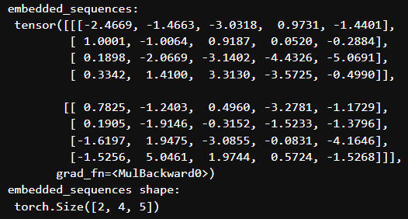
Layer – Input Embedding
nb_input_embedding.ipynb
import sys
sys.path.append('../')
import torch
from transformer.layer import InputEmbedding
# Initiate parammeters
vocab_size = 10
d_model = 5
# Create an instance of our InputEmbedding class
input_embedding = InputEmbedding(vocab_size, d_model)
# Suppose a batch of 2 sequences
sequences = torch.tensor([[1, 2, 3, 4], [5, 6, 7, 8]])
# Pass our sequences through the input embedding
embedded_sequences = input_embedding(sequences)
print("embedded_sequences: \n", embedded_sequences)
print("embedded_sequences shape: \n", embedded_sequences.shape)

Slide 50
Layer – Positional Encoding
layer.py
import torch
import torch.nn as nn
class PositionalEncoding(nn.Module):
def __init__(self, d_model: int, seq_len: int, dropout: float) -> None:
super().__init__()
self.dropout = nn.Dropout(dropout)
# Compute the positional encodings once in log space.
position = torch.arange(0, seq_len, dtype=torch.float).unsqueeze(1)
base = 10000.0 ** (-1.0 / d_model)
div_term = torch.pow(base, torch.arange(0, d_model, 2).float()) # Compute the positional encodings
pe = torch.zeros(seq_len, d_model)
pe[:, 0::2] = torch.sin(position * div_term)
pe[:, 1::2] = torch.cos(position * div_term)
pe = pe.unsqueeze(0) # Register the positional encodings as a buffer.
self.register_buffer("pe", pe)

Slide 51
Layer – Positional Encoding
layer.py
def forward(self, x): # x(embeded sequence): [batch_size, seq_len, d_model]
# Add the positional encodings to the input embeddings,
# Then apply dropout to the result.
x = x + (self.pe[:, : x.shape[1], :]).requires_grad_(False)
# self.pe[:, :x.shape[1], :] is to adapt the shape of decoder input in case of traning or inference
return self.dropout(x) # [batch_size, seq_len, d_model].

Slide 52
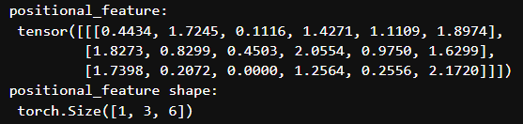
Layer – Positional Encoding
nb_positional_encoding.ipynb
import sys
sys.path.append('../')
import torch
from transformer.layer import PositionalEncoding
# Initiate parammeters
seq_len = 3
d_model = 6
batch_size = 1
dropout = 0.1
# Create an instance of our PositionalEncoding class
pos_encoding = PositionalEncoding(d_model, seq_len, dropout)
# Create a random embedded sequence
torch.manual_seed(68) # for reproducible result
x = torch.rand(batch_size, seq_len, d_model)
# Pass our sequences through the positional encoding
positional_feature = pos_encoding(x)
print("positional_feature: \n", positional_feature)
print("positional_feature shape: \n", positional_feature.shape)

Slide 54
Layer – Multi Head Attention
layer.py
import torch
import torch.nn as nn
class MultiHeadAttention(nn.Module):
def __init__(self, d_model: int, h: int, dropout: float) -> None:
super().__init__()
self.d_model = d_model
self.h = h # Ensure that the embedding dimensionality is divisible by the number of heads.
assert d_model % h == 0, "d_model % num_heads should be zero"
self.d_k = d_model // h
# Initialize the linear transformations for the queries, keys, values, and output.
self.w_q = nn.Linear(d_model, d_model, bias=False)
self.w_k = nn.Linear(d_model, d_model, bias=False)
self.w_v = nn.Linear(d_model, d_model, bias=False)
self.w_o = nn.Linear(d_model, d_model, bias=False) # Initialize the dropout layer.
self.dropout = nn.Dropout(dropout)

Slide 55
Layer – Multi Head Attention
layer.py
# The attention function calculates the attention scores for a given query, key, and value.
@staticmethod
def attention(query_k, key_k, value_k, d_k, mask=None, dropout=nn.Dropout):
# query_k | key_k | value_k: [batch_size, h, seq_len, d_k]
# mask: [batch_size, 1, seq_len, seq_len]
# Calculate the attention scores.
attention_score = (query_k @ key_k.transpose(-2, -1)) / math.sqrt(d_k)
# Apply the mask, if provided.
if mask is not None:
attention_score = attention_score.masked_fill(mask == 0, -1e9)
# Apply the softmax and dropout function to the attention scores.
attention_score = torch.softmax(attention_score, dim=-1)
attention_score = dropout(attention_score)
# Return the weighted sum of the values, along with the attention scores.
# [batch_size, h, seq_len, d_k], [batch_size, h, seq_len, seq_len]
return (attention_score @ value_k, attention_score)

Slide 56
Layer – Multi Head Attention
layer.py
# The forward method is called when we pass input data into this layer.
def forward(self, query, key, value, mask=None):
# query | key | value: [batch_size, seq_len, d_model]
# mask: [batch_size, 1, seq_len, seq_len]
# Apply the linear transformations to the query, key, and value.
query_k = self.w_q(query)
key_k = self.w_k(key)
value_k = self.w_v(value)
# Reshape and transpose the queries, keys, and values
query_k = query_k.view(query_k.shape[0], query_k.shape[1], self.h, self.d_k).transpose(1, 2)
key_k = key_k.view(key_k.shape[0], key_k.shape[1], self.h, self.d_k).transpose(1, 2)
value_k = value_k.view(value_k.shape[0], value_k.shape[1], self.h, self.d_k).transpose(1, 2)

Slide 57
Layer – Multi Head Attention
layer.py
# Calculate the attention.
attention, _ = self.attention(query_k, key_k, value_k, self.d_k, mask, self.dropout)
# Concatenate the attention heads.
# [batch_size, h, seq_len, d_k] -> [batch_size, seq_len, h, d_k] -> [batch_size, seq_len, d_model]
attention = (attention.transpose(1, 2)
.contiguous()
.view(attention.shape[0], -1, self.d_model)
)
# Apply the output linear transformation and return the result.
return self.w_o(attention) # [batch_size, seq_len, d_model]

Slide 58
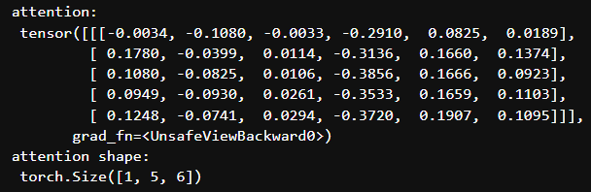
Layer – Multi Head Attention
nb_multi_head_attention.ipynb
import sys
sys.path.append('../')
import torch
from transformer.layer import MultiHeadAttention
# Initiate config
batch_size=1
seq_len=5
d_model = 6
h = 3
dropout = 0.1
# Create an instance of the MultiHeadAttention class
multi_head_attention = MultiHeadAttention(d_model, h, dropout)
# Create random tensors
torch.manual_seed(68) # for reproducible result
input_tensor = torch.rand(batch_size, seq_len, d_model)
# query, key, value.
query = input_tensor.clone()
key = input_tensor.clone()
value = input_tensor.clone()
# Call multi-head attention layer
attention = multi_head_attention(query, key, value)
print("attention: \n", attention)
print("attention shape: \n", attention.shape)

Slide 60
Layer – Feed Forward
layer.py
import torch
import torch.nn as nn
class FeedForward(nn.Module):
def __init__(self, d_model: int, d_ff: int, dropout: float) -> None:
super().__init__()
# Initialize the first linear transformation, d_model → d_ff.
self.linear1 = nn.Linear(d_model, d_ff)
# Initialize the second linear transformation, d_ff → d_model.
self.linear2 = nn.Linear(d_ff, d_model)
# Initialize the dropout layer.
self.dropout = nn.Dropout(dropout)
def forward(self, x): # x: [batch_size, seq_len, d_model]
return self.linear2(
self.dropout(torch.relu(self.linear1(x)))) # [batch_size, seq_len, d_model].

Slide 61
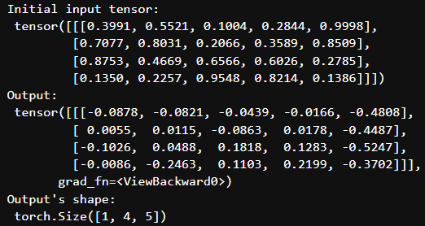
Layer – Feed Forward
nb_feed_forward.ipynb
import sys
sys.path.append('../')
import torch
from transformer.layer import FeedForward
# Initiate configuration
d_model = 5
batch_size=1
seq_len=4
d_ff = 2048
dropout = 0.1
# Create an instance of the FeedForward class
ff = FeedForward(d_model, d_ff, dropout)
# Create a random tensor to represent a batch of sequences
torch.manual_seed(68) # for reproducible result of random process
x = torch.rand(batch_size, seq_len, d_model)
# Pass the tensor through the feed-forward network
output = ff(x)
print("Initial input tensor: \n", x)
print("Output: \n", output)
print("Output's shape: \n", output.shape)

Slide 63
Layer – Layer Normalization
layer.py
class LayerNorm(nn.Module):
def __init__(self, d_model: int, eps: float = 1e-6) -> None:
super().__init__()
# Initialize the scale and shift parameters, which are learnable.
self.para_mul = nn.Parameter(torch.ones(d_model))
self.para_bias = nn.Parameter(torch.zeros(d_model))
# Store the epsilon value.
self.eps = eps
def forward(self, x): # x: [batch_size, seq_len, d_model]
# Calculate the mean and standard deviation of the input
mean = x.mean(dim=-1, keepdim=True)
std = x.std(dim=-1, keepdim=True)
# Scale and shift the normalized value, [batch_size, seq_len, d_model]
return (self.para_mul * (x - mean) / (std + self.eps) + self.para_bias)

Slide 64
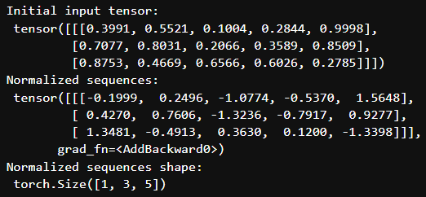
Layer – Layer Normalization
nb_layer_normalization.ipynb
import sys
sys.path.append('../')
import torch
from transformer.layer import LayerNorm
# Initiate configuration
d_model = 5
batch_size = 1
seq_len = 3
# Create an instance of our LayerNorm class
layer_norm = LayerNorm(d_model)
# Create a random tensor to represent a batch of sequences
torch.manual_seed(68) # for reproducible result
x = torch.rand(batch_size, seq_len, d_model)
# Pass our sequences through the layer normalization
normalized_sequences = layer_norm(x)
print("Initial input tensor: \n", x)
print("Normalized sequences: \n", normalized_sequences)
print("Normalized sequences shape: \n", normalized_sequences.shape)

Slide 66
Layer – Residual Connection
layer.py
class ResidualConnection(nn.Module):
def __init__(self, d_model: int, dropout: float) -> None:
super().__init__()
# Initialize the layer normalization layer.
self.norm = LayerNorm(d_model)
# Initialize the dropout layer.
self.dropout = nn.Dropout(dropout)
def forward(self, x, sublayer): # x: [batch_size, seq_len, d_model]
# Apply layer normalization to the input, passes the result through the sublayer
return x + self.dropout(sublayer(self.norm(x))) # [batch_size, seq_len, d_model]

Slide 67
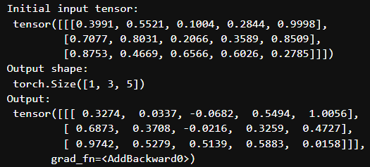
Layer – Residual Connection
nb_residual_connection.ipynb
import sys
sys.path.append('../')
import torch
from transformer.layer import FeedForward, ResidualConnection
# Initiate configuration
d_model = 5
d_ff=2048
batch_size=1
seq_len=3
dropout = 0.1
# Create an instance of the ResidualConnection and FeedForward classes
residual_connection = ResidualConnection(d_model, dropout)
feed_forward = FeedForward(d_model, d_ff=d_ff, dropout=dropout)
# Create a random input tensor
torch.manual_seed(68) # reproducible
x = torch.rand(batch_size, seq_len, d_model)
# Call residual connection
output = residual_connection(x, feed_forward)
print("Initial input tensor: \n", x)
print("Output shape: \n", output.shape)
print("Output: \n", output)

Slide 69
Layer – Projection
layer.py
class Projection(nn.Module):
def __init__(self, d_model: int, vocab_size: int) -> None:
super().__init__()
# Initialize the linear transformation
# that projects the input into the vocabulary space.
self.projection = nn.Linear(d_model, vocab_size)
def forward(self, x): # x: [batch_size, seq_len, d_model]
# It applies the linear transformation to the input.
return self.projection(x) # [batch_size, seq_len, vocab_size].

Slide 70
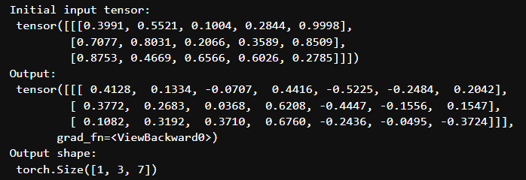
Layer – Projection
nb_projection.ipynb
import sys
sys.path.append('../')
import torch
from transformer.layer import Projection
# Initiate configuration
d_model = 5
vocab_size = 7
batch_size=1
seq_len=3
# Create an instance of the Projection class
projection = Projection(d_model, vocab_size)
# Create a random tensor to represent a batch of sequences
torch.manual_seed(68) # for reproducible result
x = torch.rand(batch_size, seq_len, d_model)
# Pass the tensor through the projection
output = projection(x)
print("Initial input tensor: \n", x)
print("Output: \n", output)
print("Output shape: \n", output.shape)

Slide 72
Implementation Plan (3/4)

Slide 73
Encoder
encoder.py
import torch.nn as nn
from transformer.layer import FeedForward, MultiHeadAttention, ResidualConnection, LayerNorm
class EncoderLayer(nn.Module):
def __init__(self, d_model: int, self_attention: MultiHeadAttention, feed_forward: FeedForward, dropout: float,
) -> None:
super().__init__()
self.self_attention = self_attention
self.feed_forward = feed_forward
# Initialize the residual connections.
self.residual_connections = nn.ModuleList([ResidualConnection(d_model, dropout) for _ in range(2)])
def forward(self, x, mask_scr=None):
# x: [batch_size, seq_len, d_model]
# First, it applies the self-attention mechanism to the input inside a residual connection.
x = self.residual_connections[0](x, lambda x: self.self_attention(x, x, x, mask_scr))
# Then, it passes the result through the feed-forward network inside another residual connection.
x = self.residual_connections[1](x, self.feed_forward)
return x # [batch_size, seq_len, d_model].

Slide 74
Encoder
encoder.py
class Encoder(nn.Module):
def __init__(self, d_model: int, encoder_layer: EncoderLayer, num_layers: int) -> None:
super().__init__()
# Initialize the layers of the encoder.
self.layers = nn.ModuleList([encoder_layer for _ in range(num_layers)])
# Initialize the layer normalization.
self.norm = LayerNorm(d_model)
# The forward method is called when we pass input data into this module.
def forward(self, x, mask_scr=None):
# x: [batch_size, seq_len, d_model]
# It passes the input through each layer in turn.
for layer in self.layers:
x = layer(x, mask_scr)
# Finally, it applies layer normalization to the output of the last layer.
return self.norm(x) # [batch_size, seq_len, d_model].

Slide 75
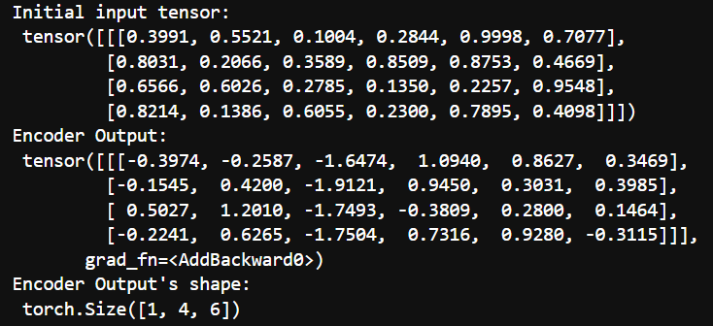
Encoder
nb_decoder.ipynb
import torch
from transformer.layer import MultiHeadAttention, FeedForward, LayerNorm
from transformer.encoder import EncoderLayer, Encoder
# Define configuration
d_model = 6 # feature dimension
h = 3 # number of heads
dropout = 0.1 # dropout ratio
d_ff = 2048 # the dimension of the feed forward network
batch = 1 # batch size
seq_len = 4 # sequence length num_layers = 3 # number of encoder layer
# Create an instance of the MultiHeadAttention & FeedForward classes
self_attention_engine = MultiHeadAttention(d_model, h, dropout)
feed_forward = FeedForward(d_model, d_ff, dropout)
# Create an instance of the EncoderLayer class
encoder_layer = EncoderLayer(d_model, self_attention_engine, feed_forward, dropout)
# Create an instance of the Encoder class
encoder = Encoder(d_model, encoder_layer, num_layers)
# Create a random tensor to represent a batch of sequences
torch.manual_seed(68) # for reproducible result of random process
x = torch.rand(batch, seq_len, d_model)
# Pass the tensor through the encoder
output = encoder(x)
print("Initial input tensor: \n", x)
print("Encoder Output: \n", output)
print("Encoder Output's shape: \n", output.shape)

Slide 77
Decoder
decoder.py
import torch.nn as nn
from transformer.layer import FeedForward, MultiHeadAttention, ResidualConnection, LayerNorm
class DecoderLayer(nn.Module):
def __init__(self, d_model: int, self_attention: MultiHeadAttention,
encoder_decoder_attention: MultiHeadAttention,
feed_forward: FeedForward, dropout: float) -> None:
super().__init__()
self.self_attention_engine = self_attention
self.encoder_decoder_attention = encoder_decoder_attention
self.feed_forward = feed_forward
# Initialize the residual connections.
self.residual_connections = nn.ModuleList([ResidualConnection(d_model, dropout) for _ in range(3)])
def forward(self, x, encoder_output, mask_src=None, mask_tgt=None):
# x: [batch_size, seq_de, d_model], encoder_output: [batch_size, seq_len, d_model]
x = self.residual_connections[0](x, lambda x: self.self_attention_engine(x, x, x, mask_tgt))
x = self.residual_connections[1](x, lambda x: self.encoder_decoder_attention(x, encoder_output, encoder_output, mask_src))
x = self.residual_connections[2](x, self.feed_forward)
return x

Slide 78
Decoder
decoder.py
class Decoder(nn.Module):
def __init__(self, d_model: int, decoder_layer: DecoderLayer, num_layers: int) -> None:
super().__init__()
# Initialize the layers of the decoder.
self.layers = nn.ModuleList([decoder_layer for _ in range(num_layers)])
# Initialize the layer normalization.
self.norm = LayerNorm(d_model)
def forward(self, x, encoder_output, mask_src=None, mask_tgt=None):
# x: [batch_size, seq_len, d_model]
# It passes the input and the encoder output through each layer in turn.
for layer in self.layers:
x = layer(x, encoder_output, mask_src, mask_tgt)
# Finally, it applies layer normalization to the output of the last layer.
return self.norm(x) # [batch_size, seq_len, d_model].

Slide 79
Decoder
nb_decoder.ipynb
import torch
from transformer.layer import MultiHeadAttention, FeedForward, LayerNorm
from transformer.decoder import DecoderLayer, Decoder
# Define configuration
d_model = 6 # feature dimension
h = 6 # number of heads
dropout = 0.1 # dropout ratio
d_ff = 2048 # the dimension of the feed forward network
batch_size = 1 # batch size
seq_len = 4 # sequence length
num_layers = 3 # number of encoder layer
# Create an instance of the MultiHeadAttention and FeedForward classes
self_attention = MultiHeadAttention(d_model, h, dropout)
encoder_decoder_attention = MultiHeadAttention(d_model, h, dropout)
feed_forward = FeedForward(d_model, d_ff, dropout)
# Create an instance of the DecoderLayer class
decoder_layer = DecoderLayer(d_model, self_attention, encoder_decoder_attention, feed_forward, dropout)
# Create an instance of the Decoder class
decoder = Decoder(d_model, decoder_layer, num_layers)
# Create a random tensor to represent a batch of sequences
torch.manual_seed(68) # for reproducible result of random process
x = torch.rand(batch_size, seq_len, d_model)
torch.manual_seed(101) # for reproducible result of random process
encoder_output = torch.rand(batch_size, seq_len, d_model)
# Pass the tensor through the decoder
output = decoder(x, encoder_output)

Slide 81
Transformer
model.py
import torch.nn as nn
from transformer.layer import InputEmbedding, PositionalEncoding, Projection
from transformer.encoder import Encoder
from transformer.decoder import Decoder
class Transformer(nn.Module):
def __init__(self, encoder: Encoder,
decoder: Decoder,
embed_src: InputEmbedding,
embed_tgt: InputEmbedding,
pos_src: PositionalEncoding,
pos_tgt: PositionalEncoding,
projection: Projection,
) -> None:
super().__init__()
self.encoder = encoder
self.decoder = decoder
self.embed_src = embed_src
self.embed_tgt = embed_tgt
self.pos_src = pos_src
self.pos_tgt = pos_tgt
self.projection = projection
def encode(self, src, mask_src=None):
src = self.embed_src(src)
src = self.pos_src(src)
return self.encoder(src, mask_src)
def decode(self, tgt, encoder_output, mask_src=None, mask_tgt=None):
tgt = self.embed_tgt(tgt)
tgt = self.pos_tgt(tgt)
return self.decoder(tgt, encoder_output, mask_src, mask_tgt)
def project(self, x):
return self.projection(x)

Slide 83
Utils – Create transformer model
utils.py
def create_tranformer_model(config, vocab_size_src, vocab_size_tgt) -> Transformer:
# Extract parameters from the configuration
d_model = config["d_model"]
num_layers = config["num_layers"]
h = config["h"]
d_ff = config["d_ff"]
dropout = config["dropout"]
seq_len = config["seq_len"]
# Initialize the source and target embedding layers
embed_src = InputEmbedding(vocab_size_src, d_model)
embed_tgt = InputEmbedding(vocab_size_tgt, d_model)
# Initialize the source & target positional encoding layers
pos_src = PositionalEncoding(d_model, seq_len, dropout)
pos_tgt = PositionalEncoding(d_model, seq_len, dropout)
# Initialize the encoder with self-attention and feed-forward layers
self_attention_encoder = MultiHeadAttention(d_model, h, dropout)
feed_forward_encoder = FeedForward(d_model, d_ff, dropout)
encoder_layer = EncoderLayer(
d_model, self_attention_encoder, feed_forward_encoder, dropout)
encoder = Encoder(d_model, encoder_layer, num_layers)

Slide 84
Utils – Create transformer model
utils.py
# Initialize the decoder with self-attention, encoder-decoder attention, and feed-forward layers
self_attention_decoder = MultiHeadAttention(d_model, h, dropout)
encoder_decoder_attention = MultiHeadAttention(d_model, h, dropout)
feed_forward_decoder = FeedForward(d_model, d_ff, dropout)
decoder_layer = DecoderLayer(
d_model,
self_attention_decoder,
encoder_decoder_attention,
feed_forward_decoder,
dropout,
)
decoder = Decoder(d_model, decoder_layer, num_layers)
# Initialize the projection layer
projection = Projection(d_model, vocab_size_tgt)
# Initialize the Transformer model
transformer = Transformer(
encoder,
decoder,
embed_src,
embed_tgt,
pos_src,
pos_tgt,
projection,
)
# Initialize the model parameters with Xavier uniform distribution
for param in transformer.parameters():
if param.dim() > 1:
nn.init.xavier_uniform_(param)
return transformer

Slide 86
Implementation Plan (4/4)

Slide 88
Engine – Train
engine.py
import os
import torch
import torch.nn as nn
from torch.utils.tensorboard import SummaryWriter
import torchmetrics.text as metrics
from transformer.mask import create_causal_mask from tqdm import tqdm
from transformer.utils import create_tranformer_model, get_checkpoint_path, create_checkpoint_path,
from transformer.utils import preprocessing_data
def train(config):
# Assign the device for computation (GPU if available, else CPU)
device = torch.device("cuda" if torch.cuda.is_available() else "cpu")
print(f"Using {device} device")
# Initiate TensorBoard writer for logging training metrics
logs = SummaryWriter(config["log_dir"])
# Check if model directory exists, if not create one to save the model weights
if not os.path.exists(config["model_dir"]):
os.mkdir("models")
# Load and preprocess the dataset
(train_dataloader, val_dataloader, _, tokenizer_src, tokenizer_tgt,) = preprocessing_data(config)

Slide 89
Engine – Train
engine.py
# Get vocab size for source and target language
vocab_size_src = tokenizer_src.get_vocab_size()
vocab_size_tgt = tokenizer_tgt.get_vocab_size()
# Create the Transformer model
model = create_tranformer_model(config, vocab_size_src, vocab_size_tgt).to(device)
# Initialize the optimizer (Adam in this case)
optimizer = torch.optim.Adam(model.parameters(), lr=config["learning_rate"], eps=1e-9)
initial_epoch = 0
global_step = 0
# Get the checkpoint path if exists
checkpoint_path = get_checkpoint_path(config)
# If a checkpoint exists, load the model and optimizer states and continue training from the last epoch
if checkpoint_path:
print(f"Loading checkpoint from {checkpoint_path}")
checkpoint = torch.load(checkpoint_path)
model.load_state_dict(checkpoint["model_state_dict"])
initial_epoch = checkpoint["epoch"] + 1
optimizer.load_state_dict(checkpoint["optimizer_state_dict"])
global_step = checkpoint["global_step"]
else:
print("No checkpoint found")

Slide 90
Engine – Train
engine.py
# Define the loss function (CrossEntropyLoss in this case)
loss_function = nn.CrossEntropyLoss(ignore_index=tokenizer_src.token_to_id("[PAD]"), label_smoothing=0.1).to(device)
# Training loop
for epoch in range(initial_epoch, config["epochs"]):
torch.cuda.empty_cache()
model.train()
batch_iterator = tqdm(train_dataloader, desc=f"Training Epoch {epoch}")
# Iterate over each batch in the training data
for batch in batch_iterator:
# Move the encoder and decoder inputs and masks to the device
encoder_input = batch["encoder_input_ids"].to(device) # (batch_size, seq_len)
decoder_input = batch["decoder_input_ids"].to(device) # (batch_size, seq_len)
encoder_mask = batch["encoder_mask"].to(device) # (batch_size, 1, 1, seq_len)
decoder_mask = batch["decoder_mask"].to(device) # (batch_size, 1, seq_len, seq_len)
# Pass the inputs through the model
encoder_output = model.encode(encoder_input, encoder_mask) # (batch_size, seq_len, d_model)
decoder_output = model.decode(decoder_input, encoder_output, encoder_mask, decoder_mask) # (batch_size, seq_len, d_model)
projection_output = model.project(decoder_output) # (batch_size, seq_len, vocab_size)
# Load target/label sequences
decoder_target = batch["decoder_target_ids"].to(device) # (batch_size, seq_len)

Slide 91
Engine – Train
engine.py
# Calculate loss
loss = loss_function(projection_output.view(-1, vocab_size_tgt), decoder_target.view(-1))
batch_iterator.set_postfix({"Training Loss": loss.item()})
# Log the loss to TensorBoard
logs.add_scalar("Training Loss", loss.item(), global_step)
logs.flush()
# Perform backpropagation
loss.backward()
# Update parameters
optimizer.step()
optimizer.zero_grad(set_to_none=True)
global_step += 1

Slide 92
Engine – Train
engine.py
# Run validation at the end of each epoch
evaluation_step(
model,
val_dataloader,
tokenizer_src,
tokenizer_tgt,
config["seq_len"],
global_step,
logs,
config["num_eval_samples"],
device,
)
# Save model checkpoint
model_checkpoint_path = create_checkpoint_path(config, f"{epoch:02d}")
torch.save(
{
"epoch": epoch,
"model_state_dict": model.state_dict(),
"optimizer_state_dict": optimizer.state_dict(),
"global_step": global_step,
},
model_checkpoint_path,
)

Slide 94
Engine – Model Inference
engine.py
def model_inference(model, encoder_input, encoder_mask, sos_id, eos_id, seq_len, device):
# Encode the input using the model
encoder_output = model.encode(encoder_input, encoder_mask) # (batch_size, seq_len, d_model)
# Initialize the decoder input with the start of sequence token
decoder_input = torch.tensor([[sos_id]]).type_as(encoder_input).to(device) # (1, 1)
# Loop until the sequence length of the decoder input equals the sequence length of the encoder input
while True:
if decoder_input.shape[1] == seq_len:
break
# Create a causal mask for the decoder input
decoder_mask = create_causal_mask(decoder_input.shape[1]).type_as(encoder_mask).to(device)
# Decode the encoder output using the model
decoder_output = model.decode(decoder_input, encoder_output, encoder_mask, decoder_mask)
# select the last token from the seq_len dimension
last_token_output = decoder_output[:, -1, :]

Slide 95
Engine – Model Inference
engine.py
# project the output to the target vocab size
projection_output = model.project(last_token_output)
# predicted_token is the indice of the max value in projection_output, meaning the id in vocabulary
_, predicted_token = torch.max(projection_output, dim=1)
decoder_input = torch.cat([decoder_input, predicted_token.unsqueeze(0).type_as(encoder_input).to(device)], dim=1)
# Break the loop if the predicted token is the end of sequence token
if predicted_token == eos_id:
break
# Return the decoder input, removing the batch dimension
return decoder_input.squeeze(0)

Slide 97
Engine – Evaluation Step
engine.py
def evaluation_step(model, val_dataloader, tokenizer_src, tokenizer_tgt, seq_len, global_step, logs, num_eval_samples, device):
# Set the model to evaluation mode
model.eval()
# Get the IDs for the start and end of sequence tokens
sos_id = tokenizer_src.token_to_id("[SOS]")
eos_id = tokenizer_src.token_to_id("[EOS]")
# Initialize lists to store the source texts, target texts, and predicted texts
source_texts = []
target_texts = []
predicted_texts = []
# Disable gradient calculations
with torch.no_grad():
# Iterate over the validation data
for batch in val_dataloader:
# Get the encoder input and mask from the batch and move them to the device
encoder_input = batch["encoder_input_ids"].to(device) # (batch_size, seq_len)
encoder_mask = batch["encoder_mask"].to(device) # (batch_size, 1, 1, seq_len)
# Assert that the batch size is 1 for evaluation
assert encoder_input.shape[0] == encoder_mask.shape[0] == 1, "Batch size must be 1 for evaluation"

Slide 98
Engine – Evaluation Step
engine.py
# Perform inference using the model
model_output = model_inference(model, encoder_input, encoder_mask, sos_id, eos_id, seq_len, device)
# Get the source text, target text, and predicted text from the batch
source_text = batch["text_src"][0]
target_text = batch["text_tgt"][0]
predicted_text = tokenizer_tgt.decode(model_output.detach().cpu().numpy())
# Append the texts to their respective lists
source_texts.append(source_text)
target_texts.append(target_text)
predicted_texts.append(predicted_text)
# Print the source text, target text, and predicted text
print(f"Source: {source_text}")
print(f"Target: {target_text}")
print(f"Predicted: {predicted_text}")
print("--------------------------------------------------")
# Break the loop if the number of evaluation samples has been reached
if len(source_texts) == num_eval_samples:
print("*************** EVALUATION COMPLETED - GO TO NEXT EPOCH ***************")
break

Slide 99
Engine – Evaluation Step
engine.py
# If logs are provided, calculate and log the BLEU score, word error rate, and character error rate
if logs:
# calculate the BLEU score
bleu_metric = metrics.BLEUScore()
bleu_score = bleu_metric(predicted_texts, target_texts)
logs.add_scalar("Validation BLEU Score", bleu_score, global_step)
logs.flush()
# calculate the word error rate
wer_metric = metrics.WordErrorRate()
wer_score = wer_metric(predicted_texts, target_texts)
logs.add_scalar("Validation Word Error Rate", wer_score, global_step)
logs.flush()
# calculate character error rate
cer_metric = metrics.CharErrorRate()
cer_score = cer_metric(predicted_texts, target_texts)
logs.add_scalar("Validation Character Error Rate", cer_score, global_step)
logs.flush()

Slide 101
Engine – Transformer translates
engine.py
def transformer_translates(src_text, model, tokenizer_src, tokenizer_tgt, seq_len, device):
# Set the model to evaluation mode.
model.eval()
# Disable gradient calculation.
with torch.no_grad():
# Tokenize the source text.
tokenized_src_text = tokenizer_src.encode(src_text)
# Calculate the number of padding tokens needed for the encoder input.
encoder_padding_num = seq_len - len(tokenized_src_text.ids) - 2 # 2: [SOS] & [EOS]
# Get the IDs of the special tokens.
sos_id = tokenizer_src.token_to_id("[SOS]")
eos_id = tokenizer_src.token_to_id("[EOS]")
pad_id = tokenizer_src.token_to_id("[PAD]")

Slide 102
Engine – Transformer translates
engine.py
# Create the encoder input by concatenating the special tokens and the tokenized source text.
encoder_input = torch.cat(
[
torch.tensor([sos_id], dtype=torch.int64),
torch.tensor(tokenized_src_text.ids, dtype=torch.int64),
torch.tensor([eos_id], dtype=torch.int64),
torch.tensor([pad_id] * encoder_padding_num, dtype=torch.int64),
], dim=0
).to(device)
# Create the encoder mask.
encoder_mask = create_encoder_mask(encoder_input, pad_id).to(device)
# Encode the input.
encoder_output = model.encode(encoder_input, encoder_mask)
# Initialize the decoder input with the start of sequence token.
decoder_input = torch.tensor([[sos_id]]).type_as(encoder_input).to(device)

Slide 103
Engine – Transformer translates
engine.py
# Loop until the sequence length is reached or the end of sequence token is predicted.
while True:
# Break the loop if the sequence length is reached.
if decoder_input.shape[1] == seq_len:
break
# Create the decoder mask.
decoder_mask = create_causal_mask(decoder_input.shape[1])
.type_as(encoder_mask)
.to(device)
# Decode the encoder output.
decoder_output = model.decode(
decoder_input,
encoder_output,
encoder_mask,
decoder_mask
)

Slide 104
Engine – Transformer translates
engine.py
# Select the last token from the sequence length dimension.
last_token_output = decoder_output[:, -1, :]
# Project the output to the target vocabulary size.
projection_output = model.project(last_token_output)
# Get the predicted token by finding the index of the maximum value in the projection output.
_, predicted_token = torch.max(projection_output, dim=1)
# Update the decoder input by appending the predicted token.
decoder_input = torch.cat([
decoder_input, predicted_token.unsqueeze(0).type_as(encoder_input).to(device)
], dim=1)
# Break the loop if the predicted token is the end of sequence token.
if predicted_token == eos_id:
break

Slide 105
Engine – Transformer translates
engine.py
# Decode the decoder input to get the translated text.
translated_text = tokenizer_tgt.decode(
decoder_input
.squeeze(0)
.detach()
.cpu()
.numpy()
)
return translated_text

Slide 107
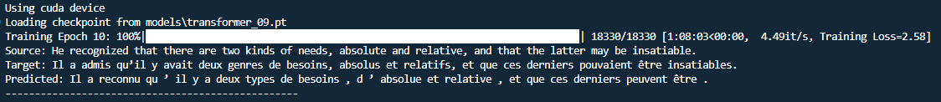
Training

Slide 108
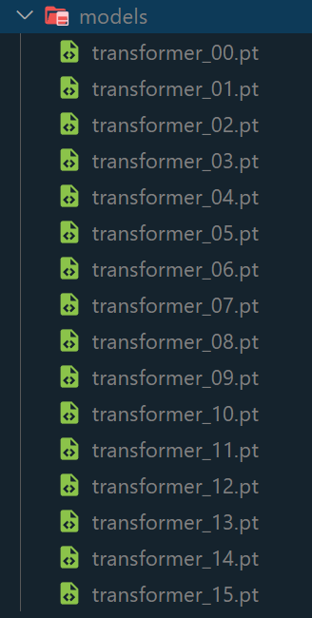
Model artifacts

Slide 109
Inference – Machine translation
nb_inference.ipynb
import torch
from transformer.utils import create_tranformer_model
from transformer.utils import load_config, get_dataset, get_tokenizer
from transformer.utils import get_checkpoint_path
from transformer.engine import transformer_translates
# Assign the device for computation (GPU if available, else CPU)
device = torch.device("cuda" if torch.cuda.is_available() else "cpu")
print(f"Using {device} device")
## Get Config, dataset, tokenizers
config_file_path = "./config.json"
config = load_config(config_file_path)
dataset = get_dataset(config)
tokenizer_src = get_tokenizer(config, dataset, config['language_source'])
tokenizer_tgt = get_tokenizer(config, dataset, config['language_target'])
vocab_size_src = tokenizer_src.get_vocab_size()
vocab_size_tgt = tokenizer_tgt.get_vocab_size()
seq_len = config["seq_len"]

Slide 110
Inference – Machine translation
nb_inference.ipynb
# Create the Transformer model
model = create_tranformer_model(config, vocab_size_src, vocab_size_tgt).to(device)
# Load latest checkpoint
model_checkpoint = get_checkpoint_path(config)
print("model_checkpoint:", model_checkpoint)
state = torch.load(model_checkpoint)
# Assign latest checkpoint to transfromer
model.load_state_dict(state['model_state_dict'])
# Source text to translate
source_text = "Market prices are shaped by the balance of supply and demand."
# call the translation function over the trained model and the source text translated_text = transformer_translates(source_text, model, tokenizer_src,
tokenizer_tgt, seq_len, device)

Slide 111
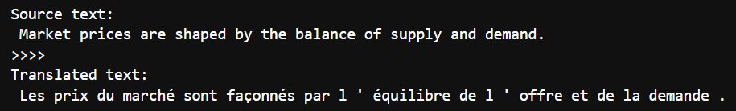
Inference – Machine translation
nb_inference.ipynb
print("Source text: \n", source_text)
print(">>>>")
print("Translated text: \n", translated_text)

Slide 113

Thank you for your watching!

